Slide 1
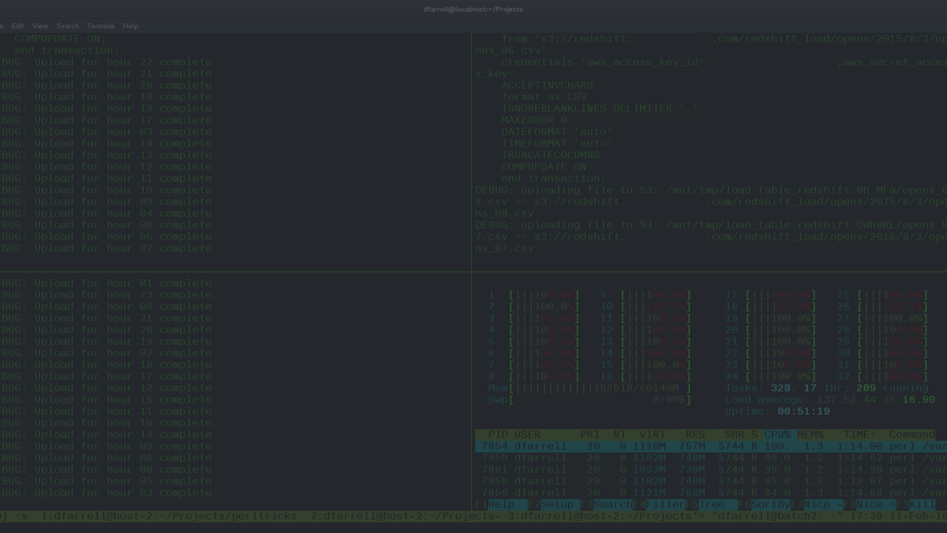

Essential Linux File Commands
Welcome to the world of Linux file management! In this presentation, we'll explore 10 essential Linux file commands that will help you navigate, create, copy, move, and manage files and directories efficiently.
K.Maitreya 21071A7234

Slide 2
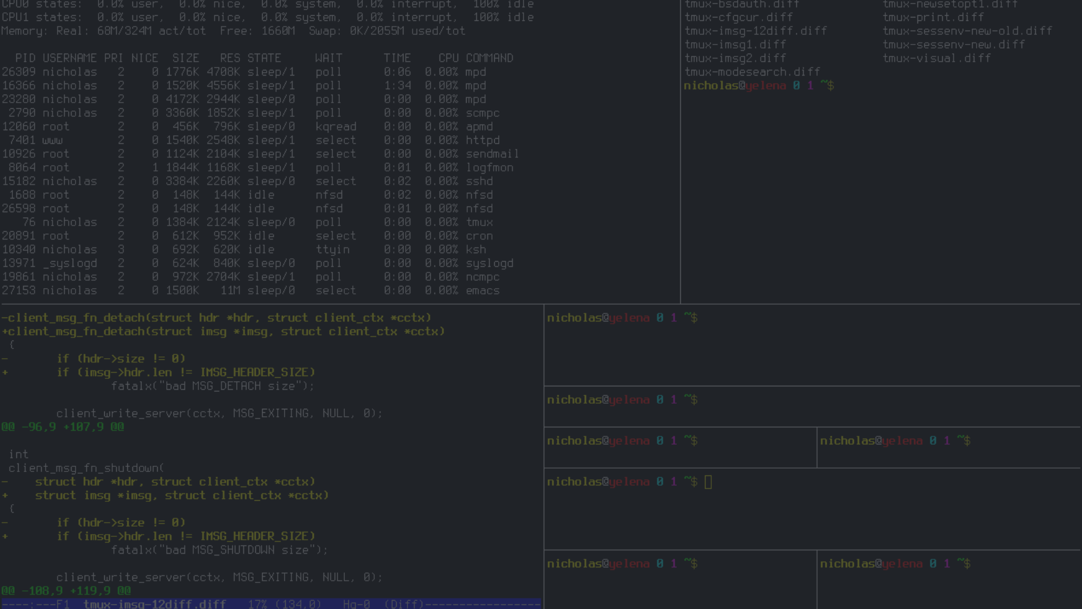
ls - List Files and Directories
The ls command lists files and directories in the current directory. This is important for exploring and understanding your file system structure. Simply enter "ls" to list the contents of the current directory or "ls /directory" to list the contents of a specific directory.

Slide 3
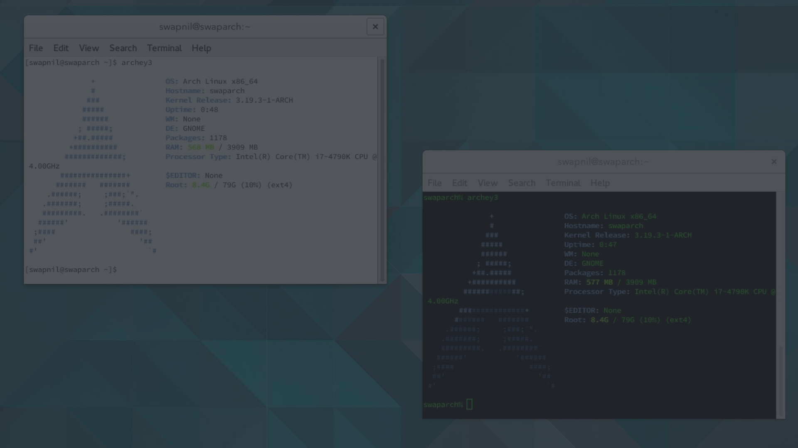
cd - Change Directory
The cd command allows you to change your current working directory. This is crucial for efficient file management. Simply enter "cd /path/to/directory" to navigate to the desired directory. Use "cd" without an argument to go back to your home directory.

Slide 4
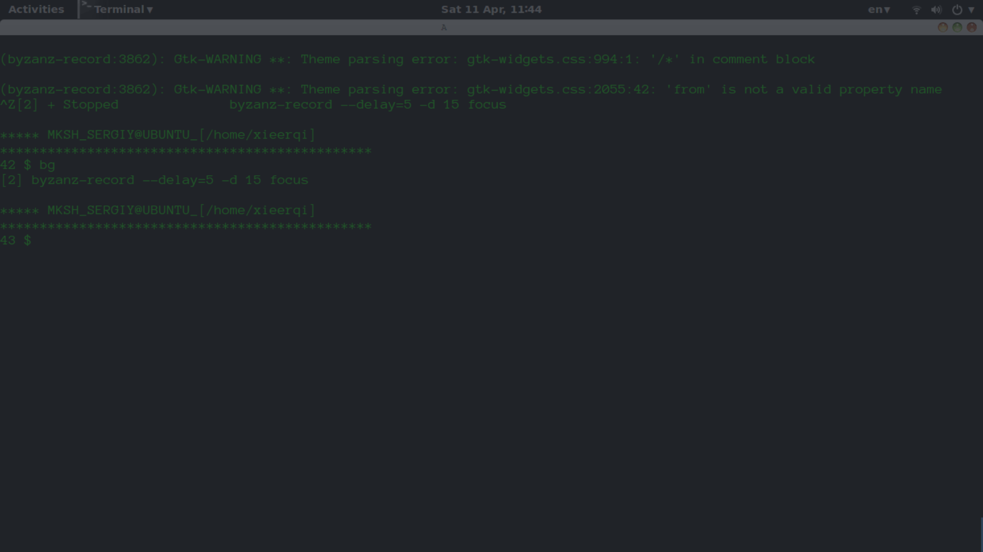
pwd - Print Working Directory
The pwd command prints the current working directory to the screen. This is useful when navigating your file system and keeping track of your location. Simply enter "pwd" to know which directory you are currently in.

Slide 5
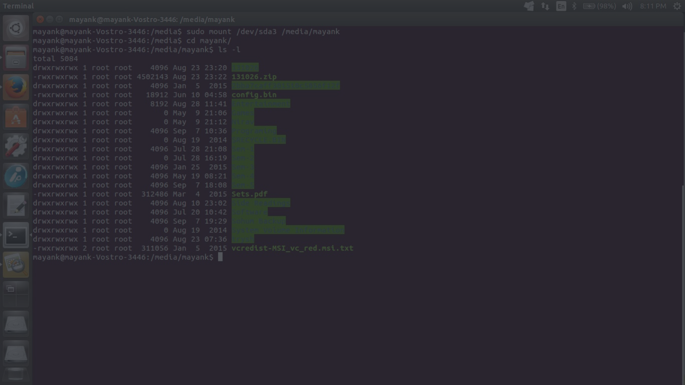
touch - Create or Update Files
The touch command is used to create an empty file or update the timestamp of an existing file. This is essential when working with scripting or automation tools. Simply enter "touch filename" to create a new file, or "touch existingfile" to update its timestamp.

Slide 6
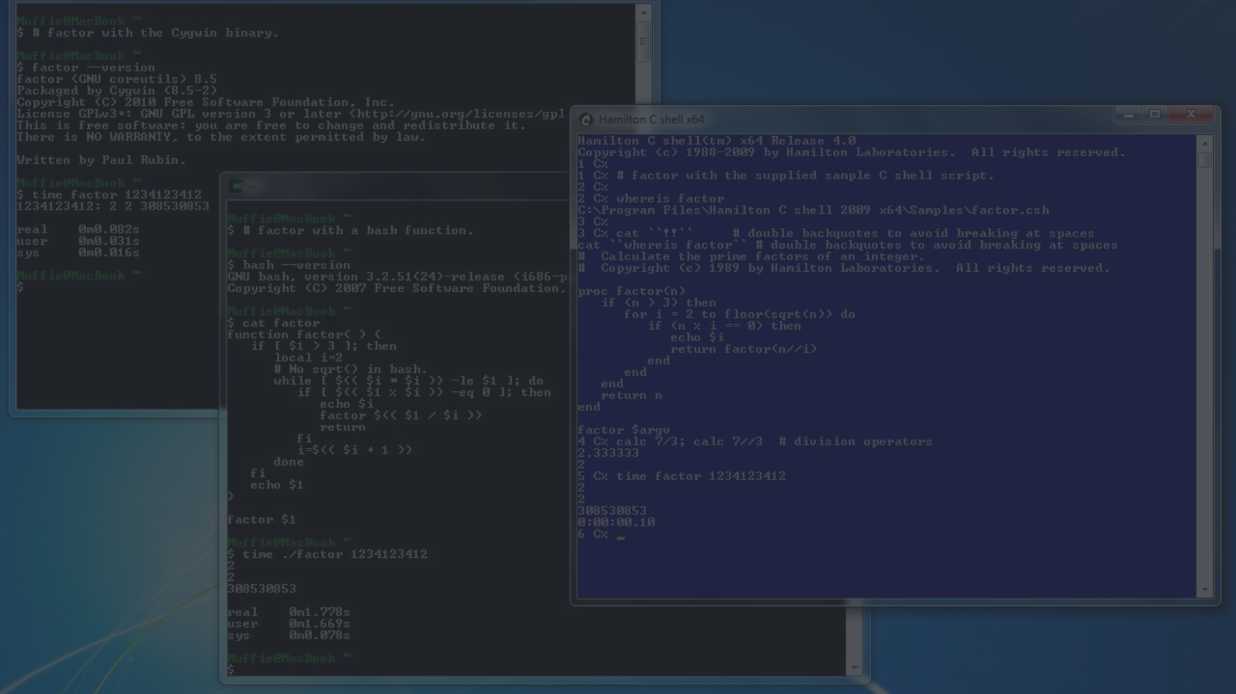
mkdir - Create Directories
The mkdir command is used to create new directories. Simply enter "mkdir directoryname" to create a new directory in the current location. This allows you to organize your files and keep your file system clean.

Slide 7
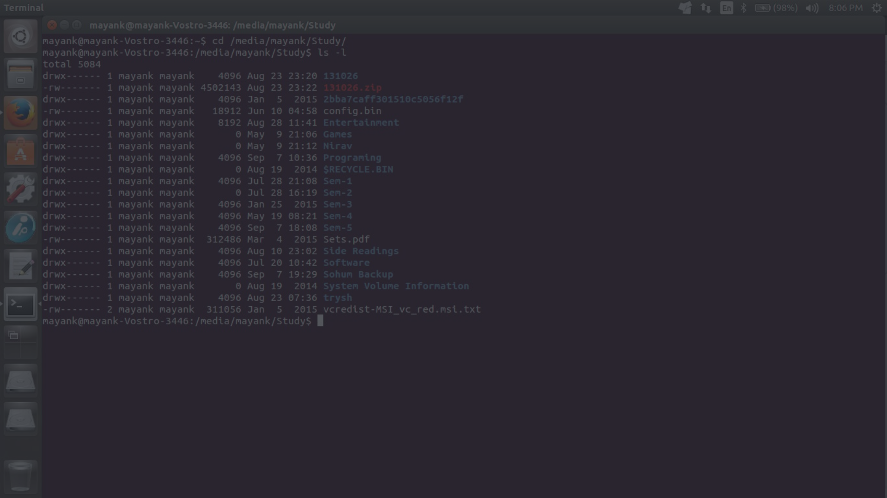
rm - Remove Files and Directories
The rm command allows you to remove files and directories. Use "rm filename" to remove a file or "rm -r directory" to remove a directory and all contents within it. This is useful for cleaning up your file system when you no longer need certain files or directories.

Slide 8
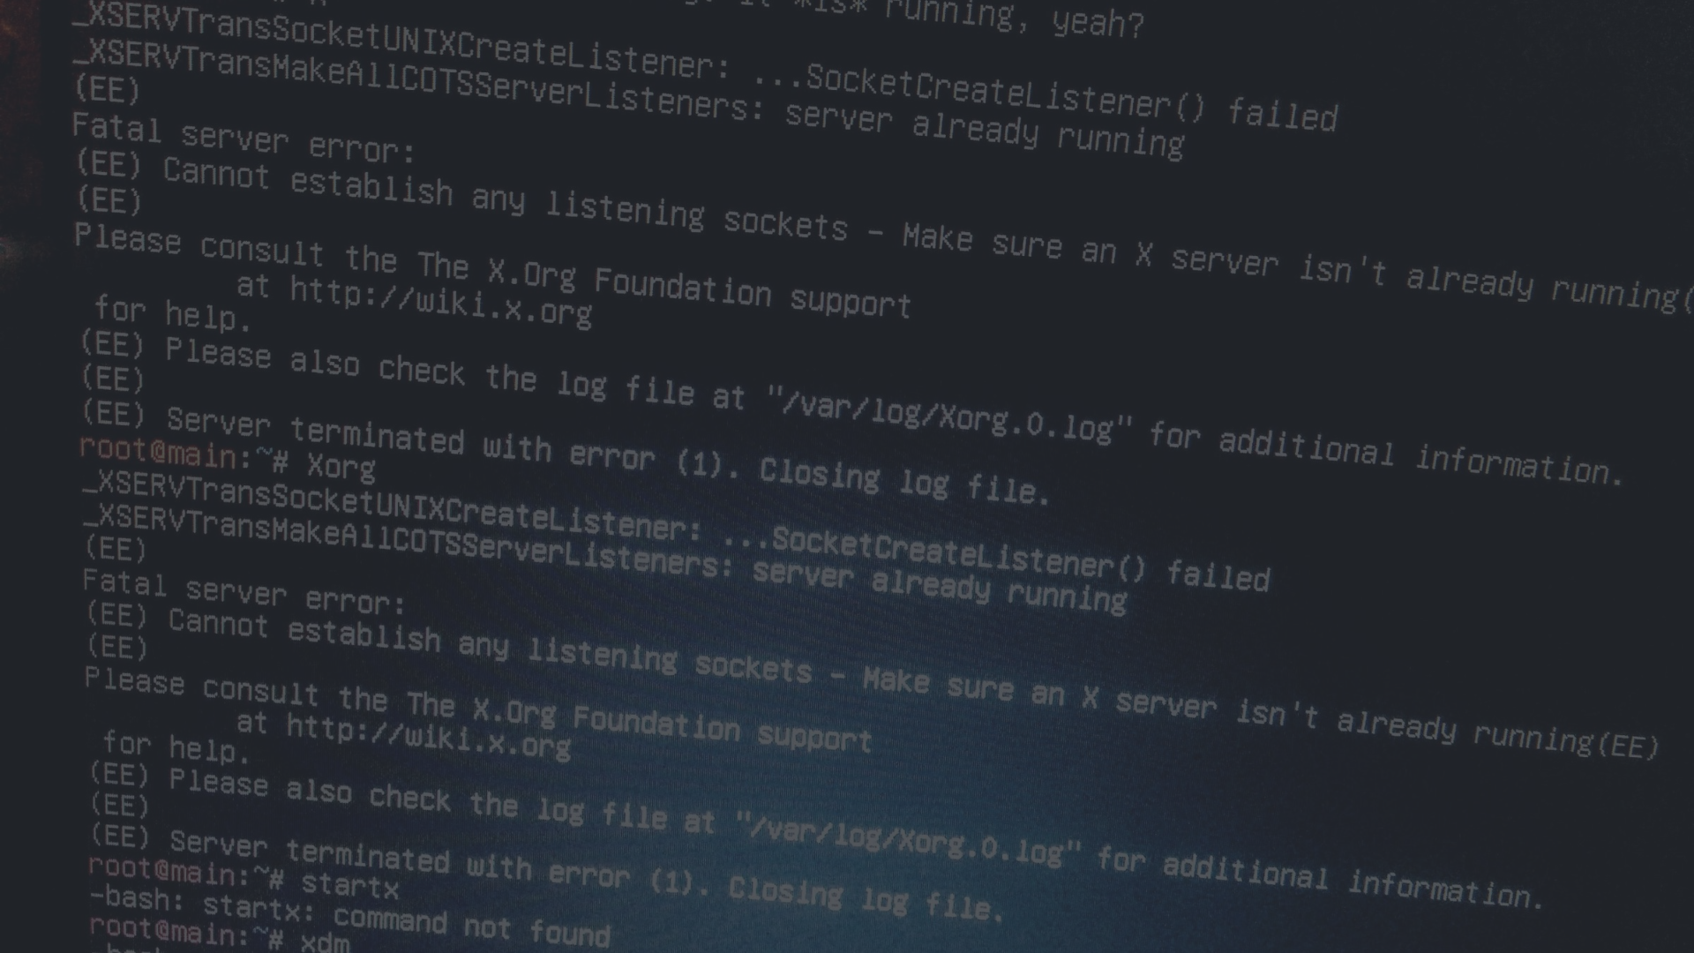
cp - Copy Files and Directories
The cp command is used to copy files and directories. Simply enter "cp source destination" to copy a file or directory from the source path to the destination path. This is useful when you need to backup or duplicate files.

Slide 9
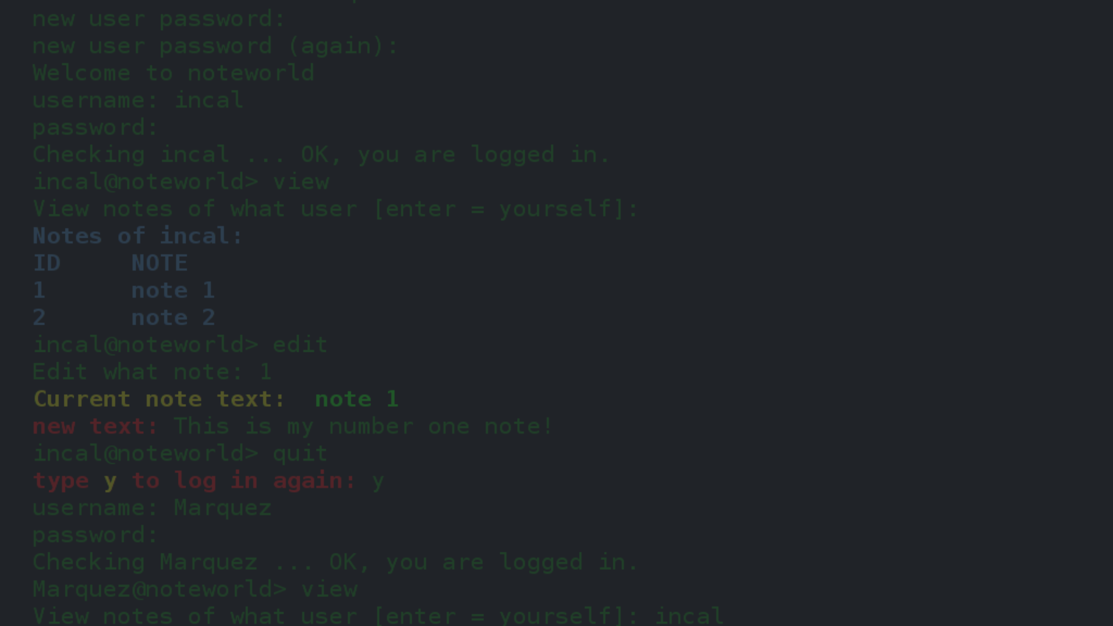
mv - Move and Rename Files
The mv command moves or renames files and directories. Simply enter "mv oldname newname" to rename a file or directory, or "mv source destination" to move a file or directory from the source path to the destination path. This is useful for restructuring your file system.

Slide 10
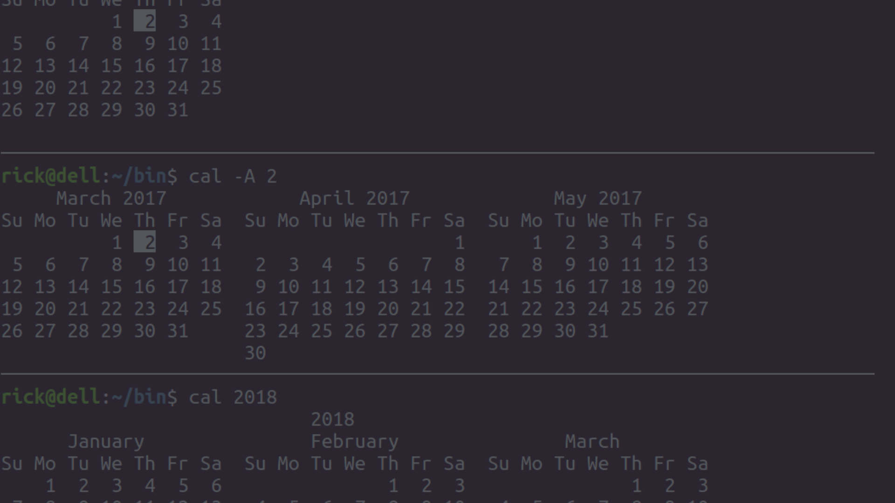
cat - Display File Contents
Use the cat command to display the contents of a file. Simply enter "cat filename" to display the content of the desired file. This is useful when you need to quickly view the contents of a file without opening it in a text editor.

Slide 11
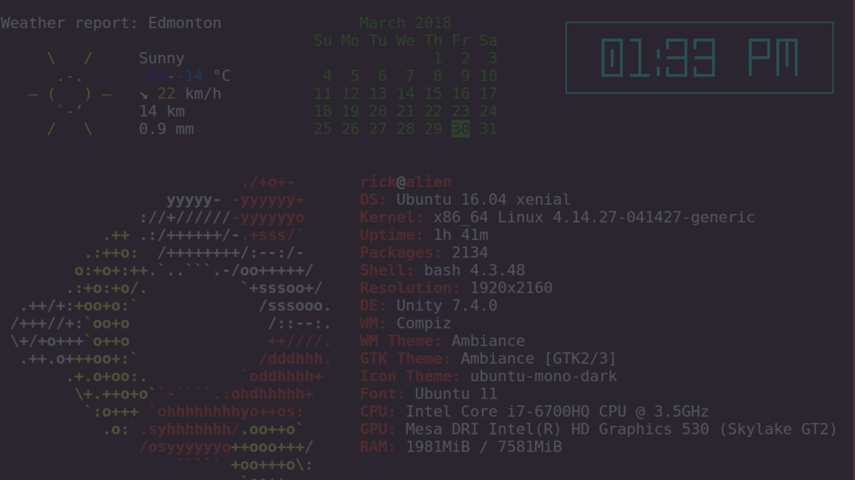
grep - Search for Text Patterns
The grep command searches for text patterns in files using regular expressions. Simply enter "grep pattern filename" to search for the desired text pattern in the specified file. This is useful when you need to quickly locate specific information within a file.

Slide 12

Conclusion
These 10 Linux file commands are fundamental for managing your files and directories efficiently on a Linux system. By mastering these commands, you can navigate your file system, create and modify files, and automate various tasks, making your Linux experience smoother and more productive.

Slide 13

Questions and Resources
Any questions or doubts? Refer to Linux documentation, online tutorials, and practice to become proficient in using these commands.

Slide 14

Thank You
Thank you for your attention! Feel free to reach out if you have any further questions or need assistance with Linux file commands.

